Slide 1
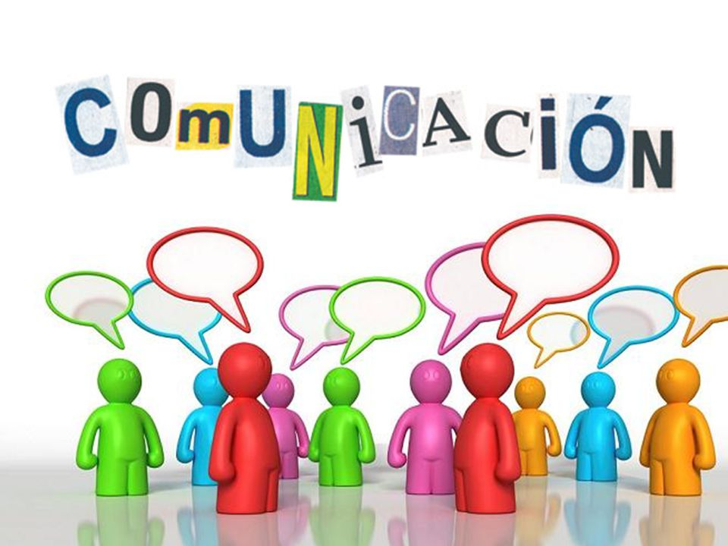
Language is a medium of communication.

Slide 2

When 2 people talk to each other , they need to speak common language.

Slide 3
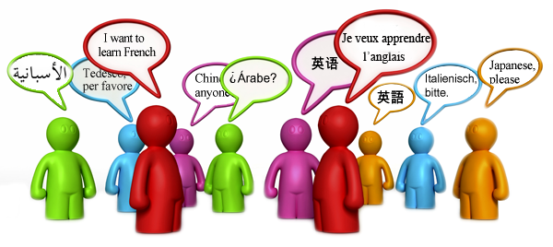
There are thousands of languages in the world.
BUT …..
Can we learn all of them ??????

Slide 4

When we learn a language, we actually learn its syntax or grammar or vocabulary.
When we speak or write that language we HAVE to follow its syntax or grammar.
Is it possible that we do not follow the vocabulary of a particular language????

Slide 5
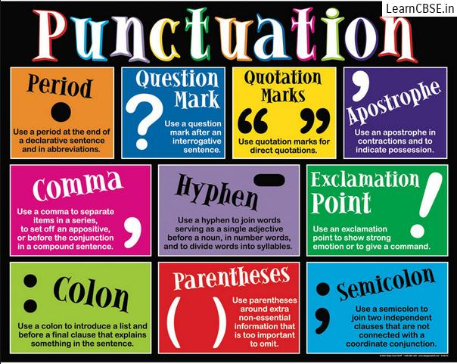
We have to follow the grammar of a language.
NO QUESTIONS ASKED !!!!!

Slide 6

How will we communicate with a person who does not speak our language ????

Slide 7
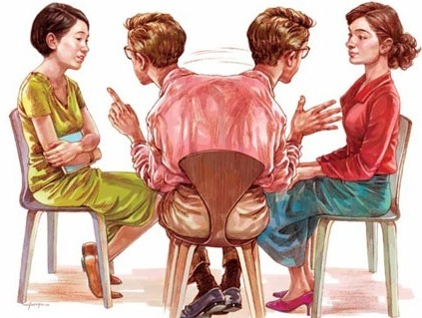
Interpreter !!!!!!!!

Slide 8
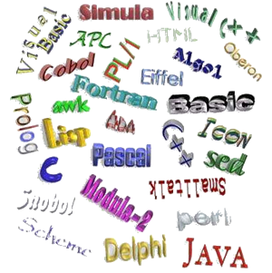
Just like natural languages there are many computer languages.

Slide 9
Why do we need a computer language ?
To give instructions to the computer.
These instructions are called PROGRAMS.

Slide 10
A program is a series of step by step instructions, given is a sequential manner, that tell the computer precisely what to do.

Slide 11
When we learn a computer language, we learn its grammar or syntax.
These instructions are English Like.
These languages are called HIGH LEVEL LANGUAGES.

Slide 12
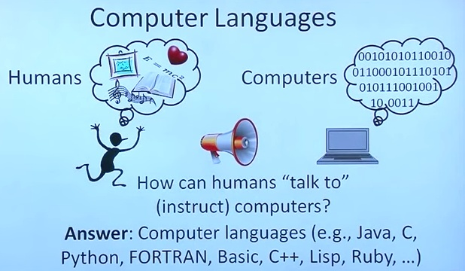
But a computer is an electronic machine.
It does not understand our language.
It only understands machine language

Slide 13

We need a translator.

Slide 14
Translator convert programs written in HIGH level languages into LOW level language or machine language which the computer understands.

Slide 15
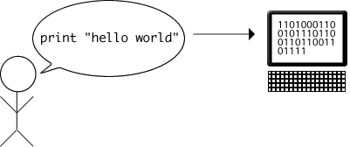
The translator will convert our program
into machine language.
The computer will
execute our program.
It will give us a result.
The translator will convert the result into
English.

